Slide 1
SMART MOBILE APPLICATION FOR GIT COLLEGE BUS

Slide 2
Contributors
Member 1
Member 2
Pooja S Harugop
Department of Computer Science Engineering
Belagavi, India
poojaharugop@gmail.com
Varun Kulkarni
Department of Mechanical Engineering
Belagavi, India
varun16799@gmail.com

Slide 3
Introduction
Android Mobile phones
Communication
Development on Internet
Navigation System such as GPS
Estimate Time of Arrival (ETA)

Slide 4
Objectives
“Smart Mobile Application” is an application for Smart phones that works on Android Operating system.
This application uses the GPS function.
Main objective is to track LIVE location of the bus.
This app generate predictions of bus arrivals at stops along the route (Notification).
The need to communicate efficiently and instantaneously is always an undying necessity.

Slide 5
Objectives
This application also tells alternative bus routes to the students in case they miss the bus from that stop.
Sometimes if there are no students on particular stop then the driver can skip that location and reach college faster.
Gets a notification of ETA.

Slide 6
Requirements
Hardware Requirements:
RAM : 512 MB or higher
Processor : 1 GHz or higher
Memory : 200 MB
Other : GPS enabled
Software Requirements:
Operating System : Android 4.1 or higher
Front-end : Android Studio
Back-end : SQLite Database
Plugins : Android SDK, ADT Plugin

Slide 7
Android
Integrated Development Environment (IDE) is used in Android development in order to make it more straight forward and quick.
It has been recommended for the developers because of its simplicity in working.
Android is basically a multitasking platform.
These applications can work simultaneously with other applications because of multitasking ability of the Android platform.

Slide 8
ADT Plugin
ADT (Android Development Tools) is a plugin developed by Google.
Its main purpose is for developing Android mobile applications in Eclipse.
It makes it easy and convenient for all the Android developers working in Eclipse environment to quickly create Android projects and debug the programs whenever needed.

Slide 9
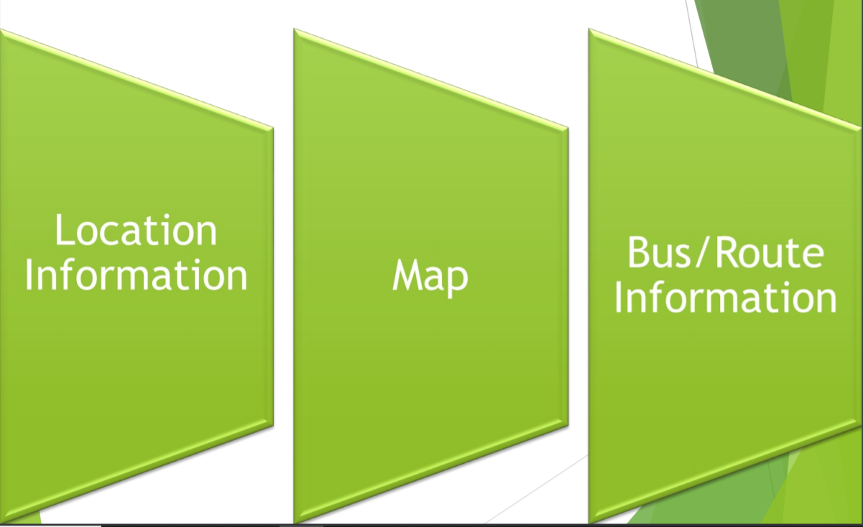
Project Module

Slide 10
Module 1- Location Info
This module depicts the process of selection of Bus no and presenting the current location of the Bus.
TECHNOLOGY APPLIED: GPS – Global Positioning System.
Client-Server Technology.

Slide 11
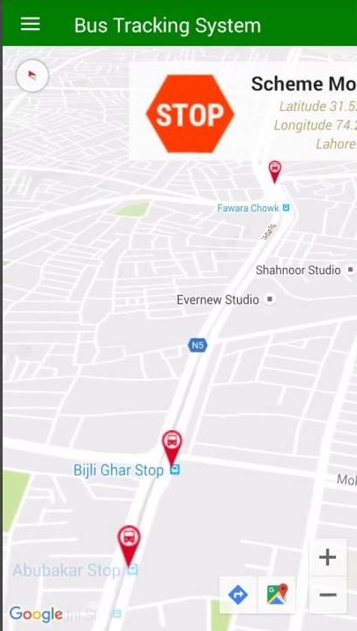
Module 2- Maps
In this Module; application is using Google-APIS to show the Maps.

Slide 12
Module 3 - Bus/Route Information
The Routes of all Buses are recorded by college management.
For this purpose we have used SQLite.
Bus In-charge or admin will update all info regarding routes.
Now when client makes request for the Bus Information it will be fetched from the database and delivered to client through server.

Slide 13
Advantages and Disadvantages
Advantages
Reduces traffic in clumsy areas.
Makes people to avoid unexpected delays.
Improves scheduling of vehicle timings.
Easy to catch local transports.
Disadvantages
GPS based location system may not work properly during inappropriate weather conditions.

Slide 14
Future Scope
This project will be put up on the cloud platform, so that it will be accessible by every Android user.
The application will prove beneficial for every bus traveler, or even tourists. Not just buses, but this application will be useful for every person travelling by any means of transport.
The Location Tracker will give the exact location of the bus which will make it easy for the passengers to travel.

Slide 15


